Slide 1
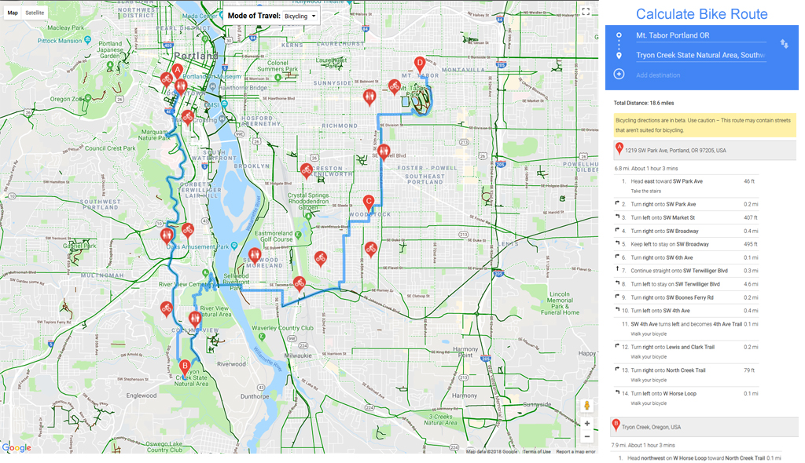
Waypoint markers on map
Enter ‘start’ and ‘end’ points
Add waypoints to route
Display turn-by-turn directions
Restroom Markers near route
Bike Shop Markers near route

